Slide 1
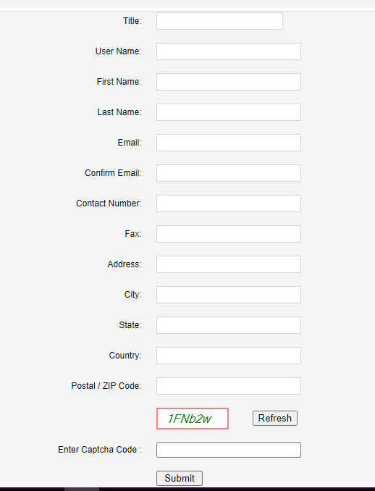
Existing
Proposed
MBBS
Dental
Nursing
Aayush
Student Faculty
Under Graduate Post Graduate
If the USER chooses Student
Year/Prof*
If the USER chooses Student
Email Id*
First Name*
Last Name*
Mobile*
College Name*
College Address
College City*
College State
College Country
College Pin /Zip Code*
Captcha Code*

Slide 2
In case of Faculty
Specialisation
Drop Down
Only for MBBS
Specialisation
Write your own
For Dental/Nursing/Aayush

